Slide 1
Lab 3
Memory Placement
Algorithm Analyses
NEU – Dec 2018

Slide 2
Memory Management/Allocation
Analyze memory assignment using First Fit, Best Fit, Next Fit
Capture statistics on the state of the memory

Slide 3
Construct a simulation environment
Simulation time starts at 0 and iterates as integers
At any given time, memory may be requested
Requests have a duration and amount
Previous requests could be released if their duration has been reached
How to handle situations where a request cannot be satisfied?
Deny/Delay (be consistent)

Slide 4
Data
A small sample data set is provided for testing
Once your code is ready, perform additional testing (you make the input)
Construct a hypothesis and test your theory (will one algorithm work very well/poorly under certain conditions?)

Slide 5
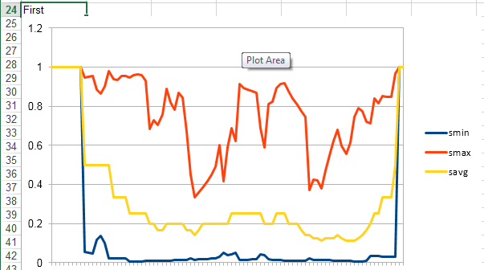
First Fit Example Trace

Slide 6
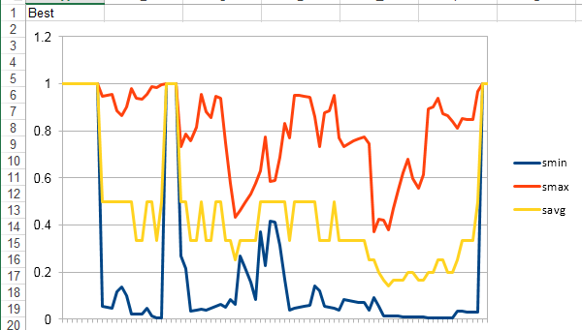
Best Fit Example Trace

Slide 7
Lab Requirements
Before: Go through references, design algorithms, draw flowchart
During: Program, debug, test
Deliverable: Report
Purpose
Flowchart/Algorithm/Methodology
Experiment data & results
Conclusions, comments, suggestions
Submit: Report & Source Code (Blackboard)
Due Midnight of 12/26 (Wednesday)

Slide 8
Syllabus: Lab Evaluation
20% Report Quality
20% Correctly understand and master the concepts and principles involved
20% Correctly design data structures and program structure
20% Carefully record experimental data, and experimental results are correct
10% During the experiment, the student is diligent, serious, and pragmatic
10% There is a certain degree of innovation

